Slide 1
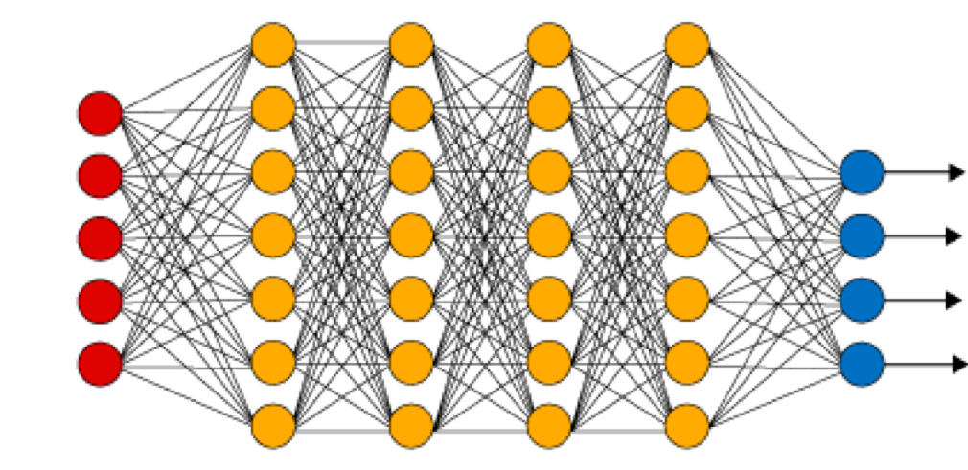
Neural Networks
Slides and etc. here:
tinyurl.com/doodleit-materials
How a computer sees
Slides by Prof. Ruizhe Ma, UMass Lowell
Notes:
https://medium.com/analytics-vidhya/what-is-cnn-a-5-year-old-guide-to-convolutional-neural-network-c9d0338c3bf7
https://becominghuman.ai/debunking-convolutional-neural-networks-cnn-with-practical-examples-688284c45b85

Slide 2
Introductions
Fred Martin, fred_martin@uml.edu
Vaishali Mahipal
Ismaila Sanusi, ismaila_sanusi@uml.edu
Srija Ghosh, srijaghosh2015@gmail.com

Slide 3
Agenda
A brief intro to neural networks and image classification
Demonstration and then computer hands-on with “DoodleIt”
Explanation of “convolution” which uses filters to extract features from images
Hands-on convolution paper-and-pencil exercise
Conversation & assessment

Slide 4
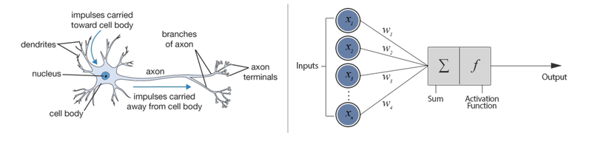
Why are they called neural network?
https://www.datacamp.com/community/tutorials/deep-learning-python

Slide 5
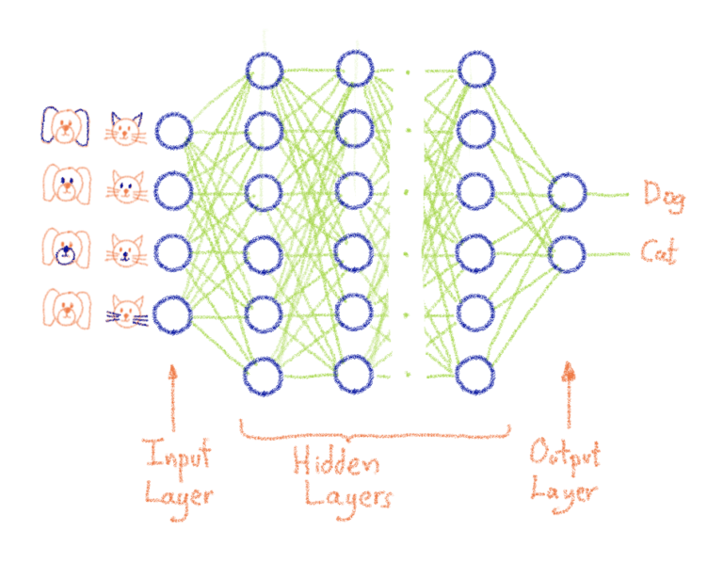

Neural Network
https://blog.ovhcloud.com/what-does-training-neural-networks-mean/
4
1
7
0

Slide 6

Convolutional Neural Network

Slide 7
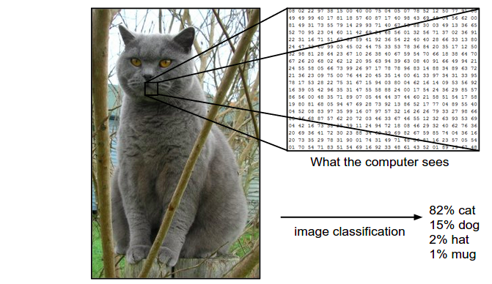
Convolutional Neural Network

Slide 8



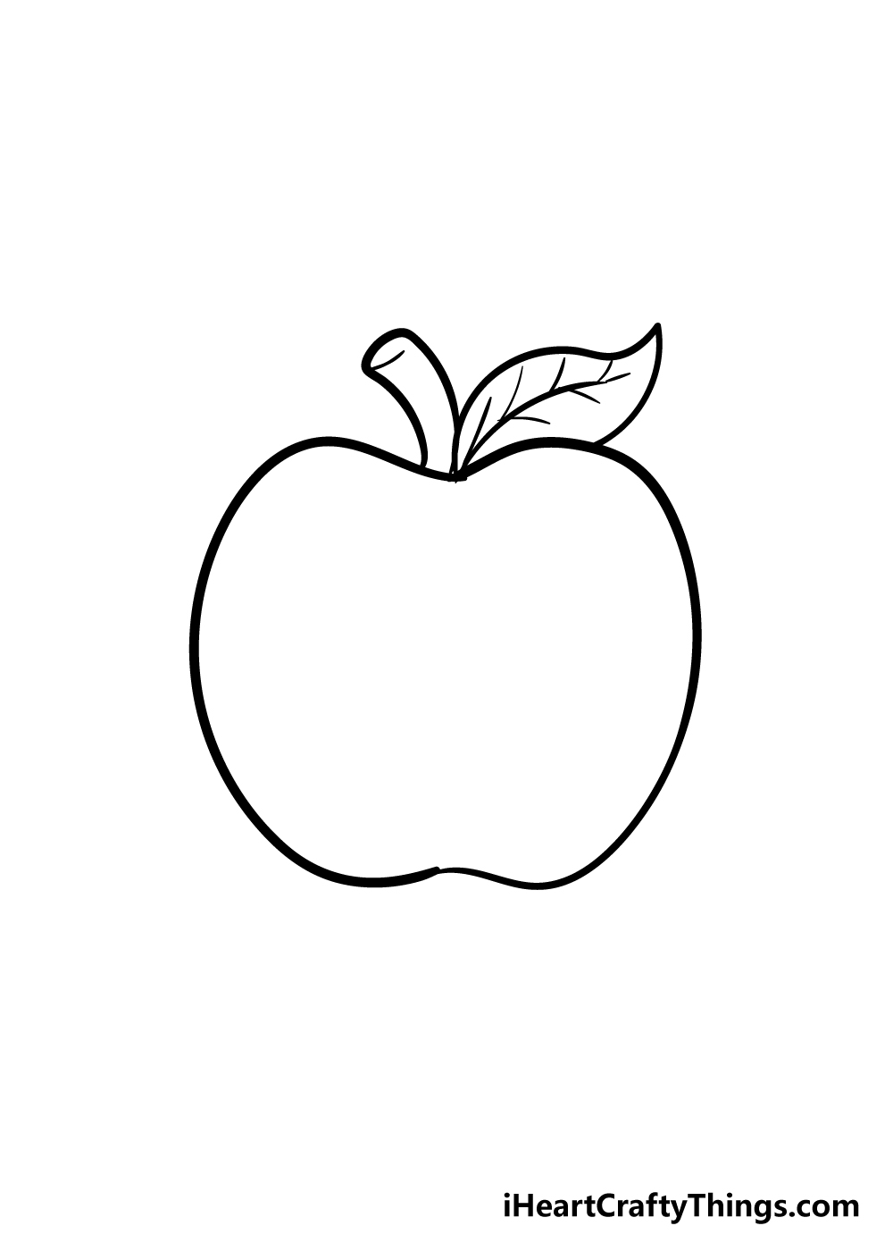
Image Classification
Awesome magic box
Cat
Label Assignment
Cat
Cake
Apple
…
Cake
Apple
We need to train a network first!
Training data (known data)

Slide 9

Image Classification
Awesome magic box
Cat
Label Assignment
Cat
Cake
Apple
…
Cake
Apple
What is this?
Training data (known data)
Testing data (new data)

Slide 10
Image Classification
I am 80% sure it is a cat.
Awesome magic box
Cat
Label Assignment
Cat
Cake
Apple
…
Cake
Apple
What is this?
Training data (known data)
Testing data (new data)

Slide 11
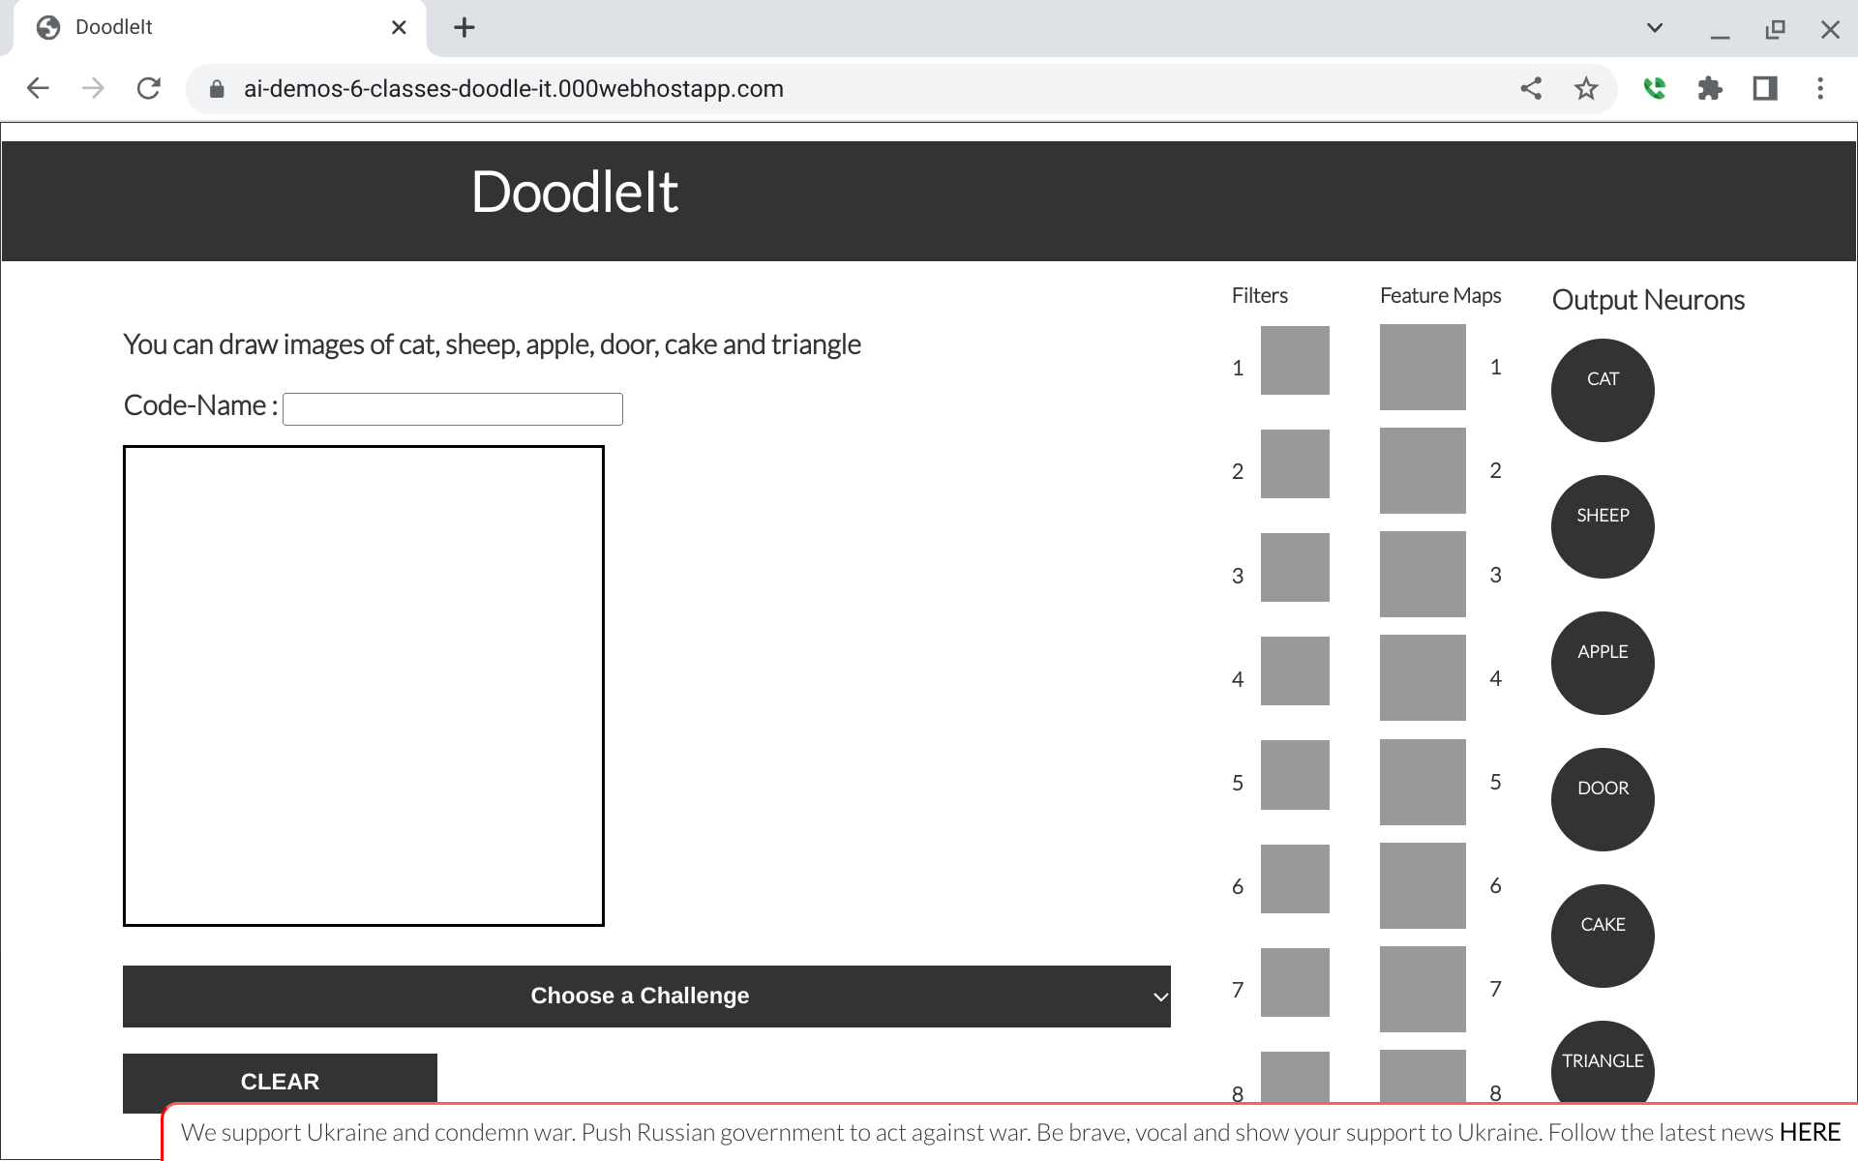

Slide 12
DEMO LINK
tinyurl.com/mydoodleit
To talk to us: cmu.zoom.us/my/srosenth

Slide 13
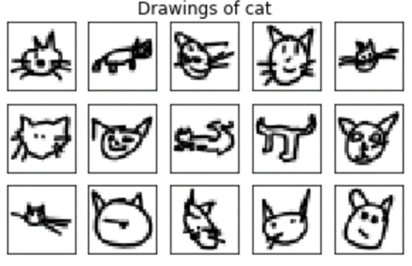
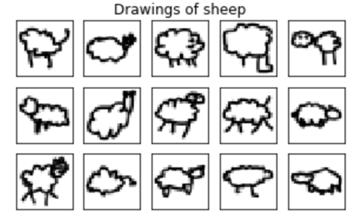
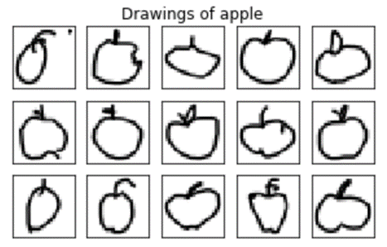
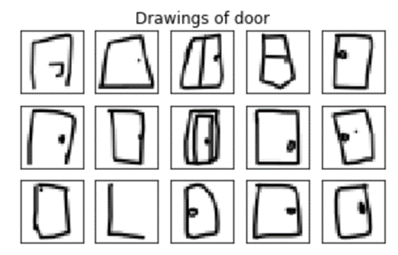
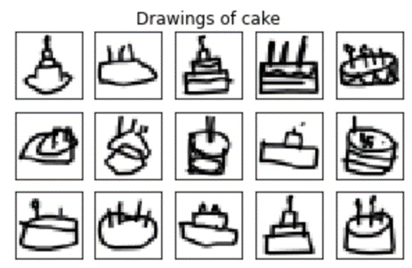
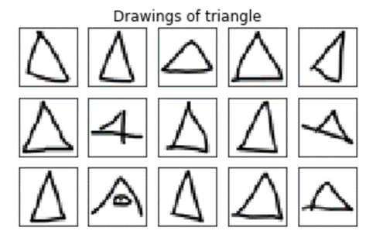
Training Data

Slide 14
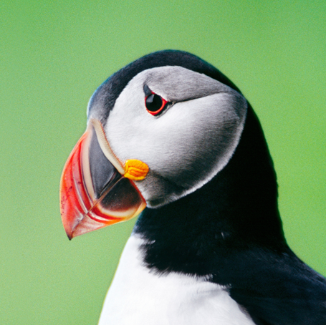
Convolutional Neural Network
2
Pixels turn to numbers
4
1
7
0
…
1

Slide 15

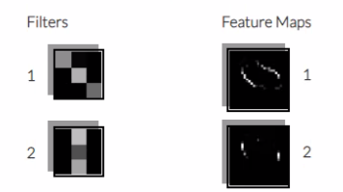
Key first step: Filters that produce Feature Maps, using “Convolution.”

Slide 16
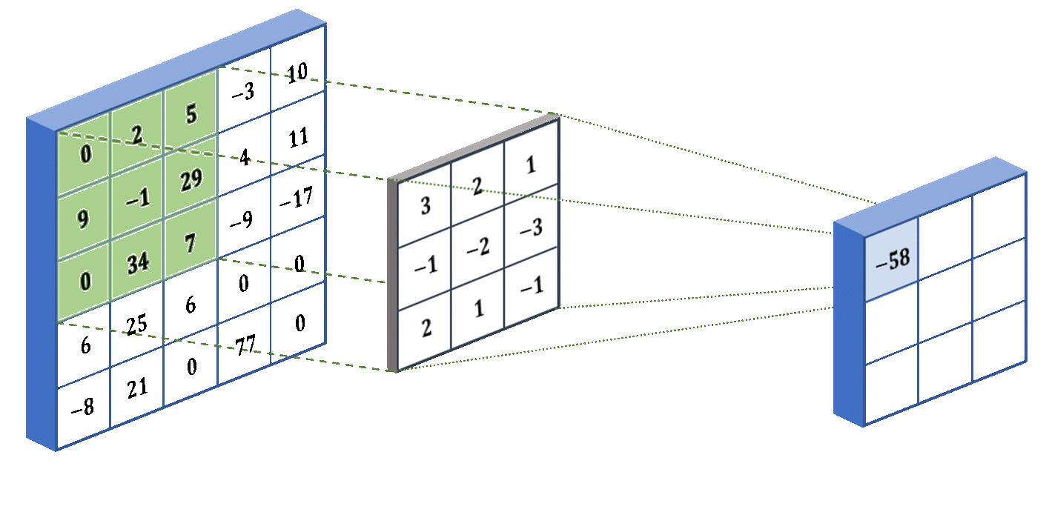
Kernel/Filter

Slide 17
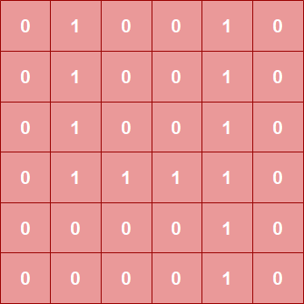
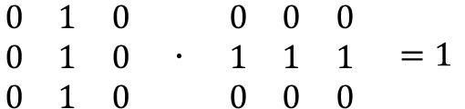
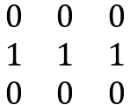
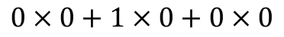
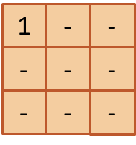
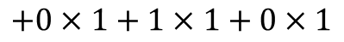
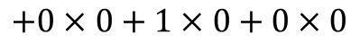
Kernel/Filter
Image
Kernel

Slide 18
Kernel/Filter
0
1
0
0
1
0
0
1
0
0
1
0
1
1
1
1
0
1
0
0
1
0
1
1
1
1
.
0
1
1
1
1
0
2
3
3
2
0
0
1
1
0
0
0
0
1
0
0
0
0
0
1
0

Slide 19
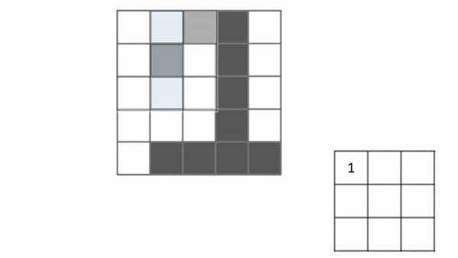
Convolution using vertical filter

Slide 20
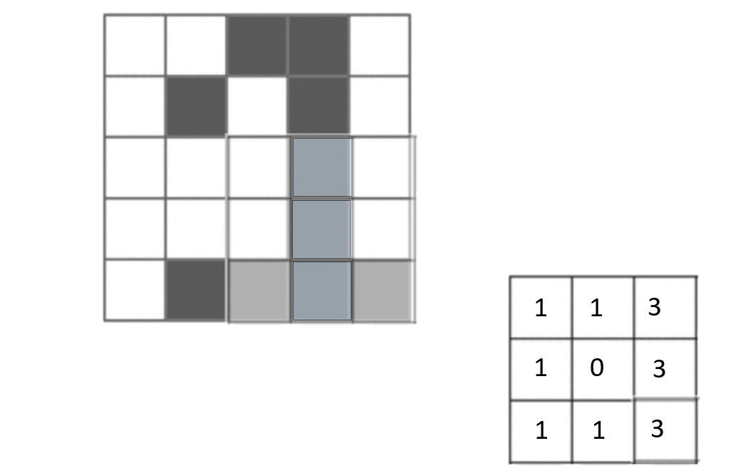
Result of Convolution using Vertical Filter

Slide 21
Now it’s your turn
Hands-on convolution activity

Slide 22

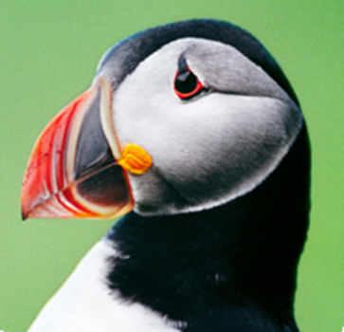
What do filters highlight?
What is more common in a picture?
Color
Edges
What do filters highlight?

Slide 23
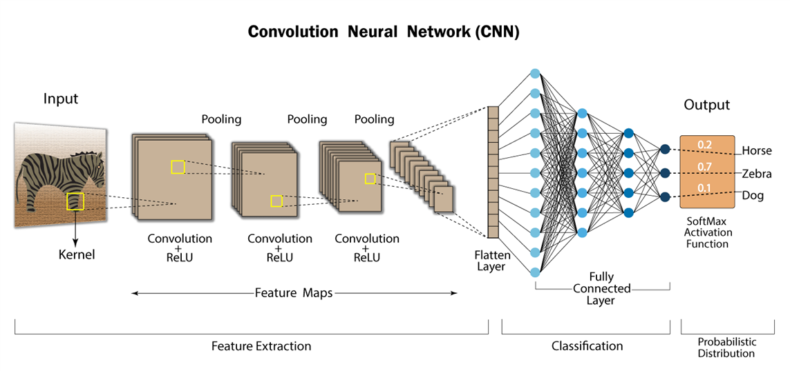
Then we feed the numbers into a network

Slide 24
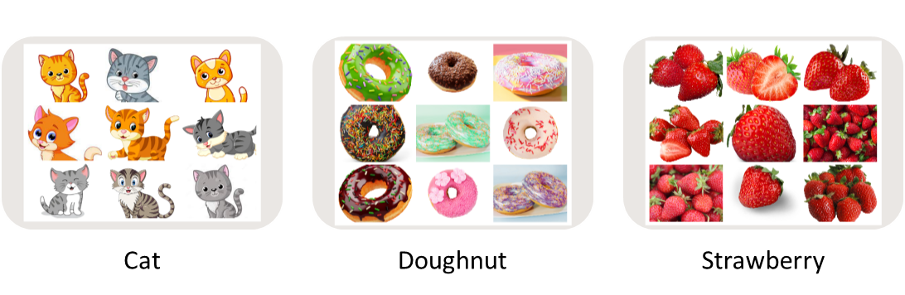

Assessment 1
Suppose we train the computer using images of three classes – cat, doughnut, and strawberry:
What do you think the model will recognize?
1. Cat
2. Doughnut
3. Strawberry
Why do you think so?
We pass the below image to the model :

Slide 25

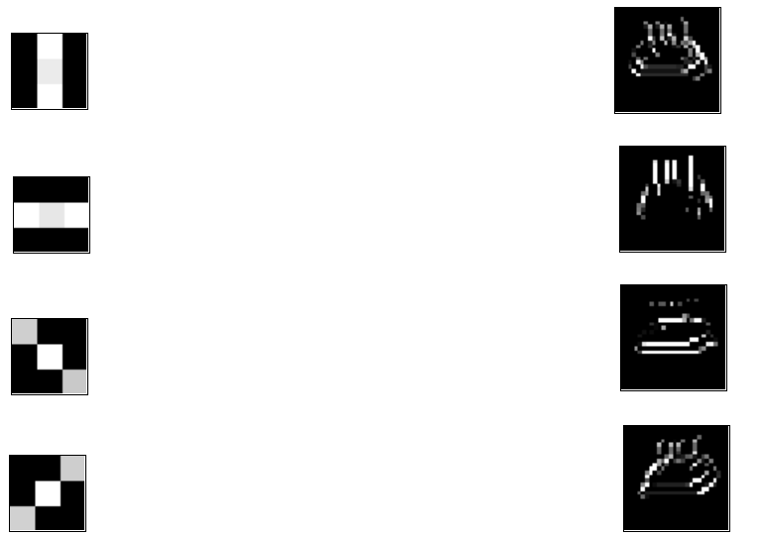
Assessment 2
You pass the following image to the computer:
Match the filters with their respective feature maps:

Slide 26

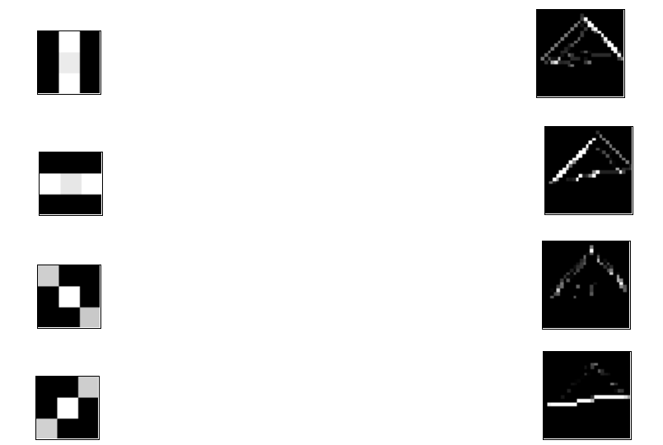
Assessment 3
You pass the following image to the computer:
Match the filters with their respective feature maps:

Slide 27
Complete post-survey for Day 5 – Neural Networks
tinyurl.com/2p8nzzrp

Slide 28
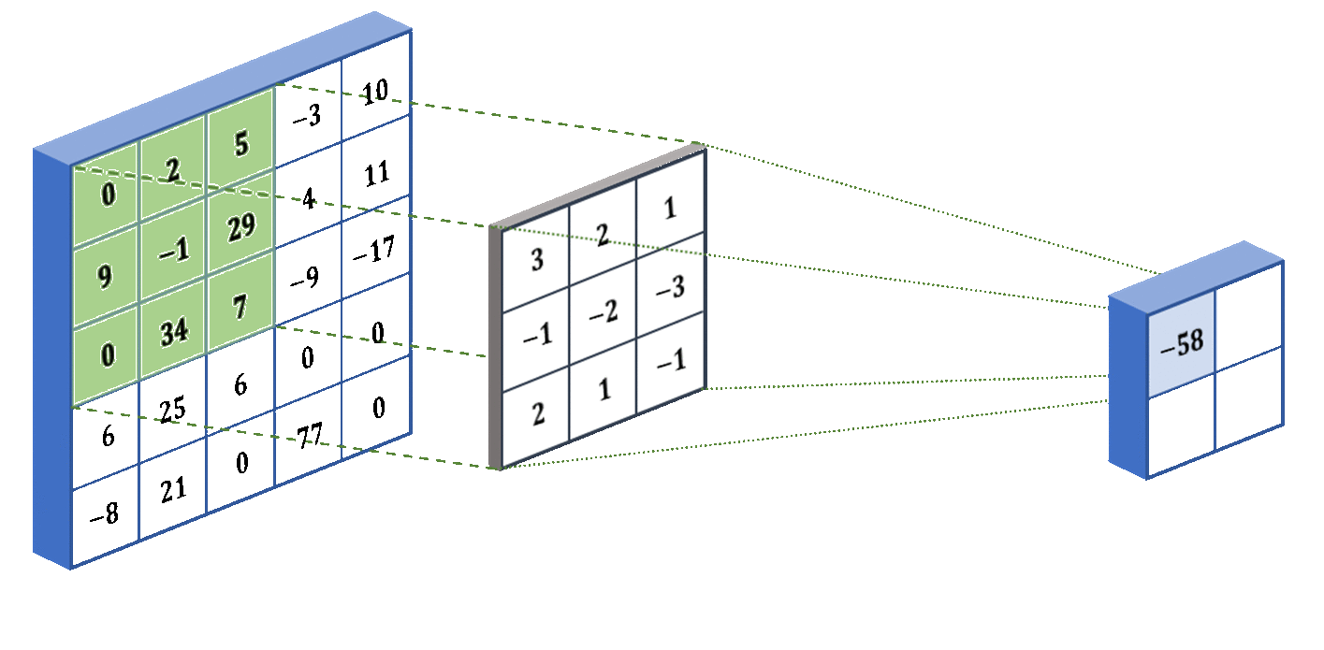
Pooling

Slide 29
Pooling
1
1
1
1
1
1
1
1
2
3
3
2
0
0
1
1
1
1
1
1
3
3
1
2
Max Pooling
Avg Pooling

